Slide 1




IMPLEMENTASI KAFKA
PT FEDERAL INTERNATIONAL FINANCE
June - August

Slide 2

TIARA YULIANDARI
11S21007
KP-24-120-D

Slide 3
BACKGROUND

Slide 4
Poor Performances on Data Processing
1
Took Couples Hours
2

Slide 5
CURRENT SYSTEM

Slide 6
Response
Third party company sends response to topic
3RD PARTY COMPANY
FIF
FIF
Request
Consume
FIFGROUP sends message to topic
FIFGROUP consumes messages fro topic

Slide 7
SYSTEM
OVERVIEW

Slide 8
01 - KAFKA IMPLEMENTATION
02 - SPRING PROJECT
03 - IMPROVES PERFORMANCE

Slide 9
ENVIRONMENT

Slide 10
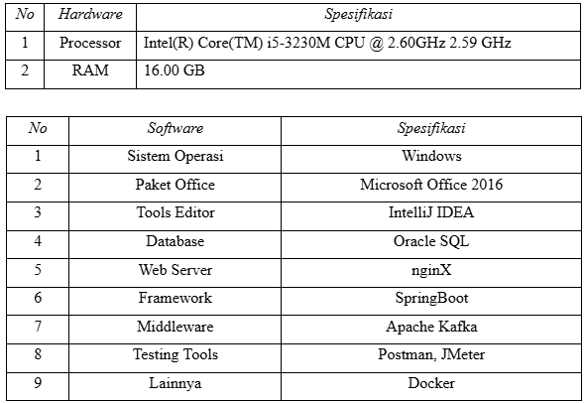

Slide 11
FUNCTIONAL DESCRIPTION

Slide 12







Kafka Topic
Third Party Company
FIFGROUP
Sync Messages
Publish message

Slide 13
SEQUENCE DIAGRAM

Slide 14
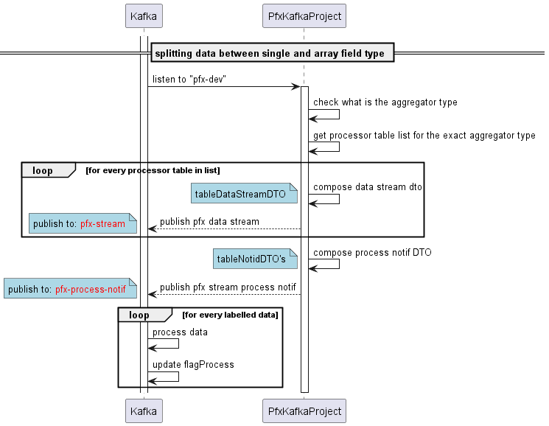

Slide 15
CODE OVERVIEW

Slide 16
THANK YOU

